Slide 1
EU circular economy initiative: Relevance to the cartridge reman industry
Vincent van Dijk
Secretary General ETIRA
European Association of Toner & Inkjet Remanufacturers, Brussels
Seminars remanexpo@paperworld, Frankfurt /Main, January 2016

Slide 2
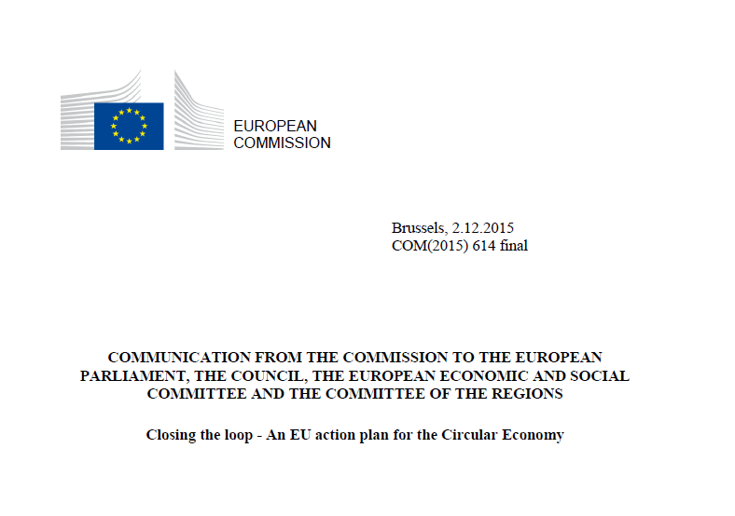

Slide 3
EU Dec 2015 Circular Economy Action Plan:
Funding of over €650 million under Horizon 2020 and €5.5 billion under the structural funds
Actions to reduce food waste
Development of quality standards for secondary raw materials to increase the confidence of operators in the single market;
Measures in the Ecodesign working plan for 2015-2017 to promote reparability, durability and recyclability of products, in addition to energy efficiency
A revised Regulation on fertilisers
Strategy on plastics in the circular economy, addressing issues of recyclability, biodegradability, the presence of hazardous substances in plastics
Actions on water reuse
Timeline for the actions proposed and a plan for a simple and effective monitoring framework

Slide 4
Proposals to amend waste legislation:
– Alignment of definitions;
– Increase of the preparing for re-use and recycling target for municipal waste to 65% by 2030;
– Increase of the preparing for reuse and recycling targets for packaging waste and the simplification of the set of targets;
– Gradual limitation of the landfilling of municipal waste to 10% by 2030;
– Harmonisation and simplification of the legal framework on by-products and end-of-waste status;
– measures to promote prevention, including for food waste, and re-use;
–minimum operating conditions for Extended Producer Responsibility
–Early Warning System for monitoring compliance with the
recycling targets
– Simplification and streamlining of reporting obligations

Slide 5
Proposals to amend waste legislation (II):
A common EU target for recycling 75% of packaging waste by 2030;
A ban on landfilling of separately collected waste;
Promotion of economic instruments to discourage landfilling ;
Simplified and improved definitions and harmonised calculation methods for recycling rates throughout the EU;
Concrete measures to promote re-use and stimulate industrial symbiosis –turning one industry's by-product into another industry's raw material;
Economic incentives for producers to put greener products on the market and support recovery and recycling schemes (e.g. for packaging, batteries, electric and electronic equipment, vehicles).

Slide 7
21 January 2016 © ANP De drie grootste banken van Nederland, ABN Amro, ING en Rabobank willen hun steentje bijdragen aan de opkomst van circulaire economie in Nederland. Het bankentrio wil bedrijven die zich focussen op hergebruik van materialen en grondstoffen makkelijker leningen geven.

Slide 11
Benefits to cartridge reman industry
Ecodesign Voluntary Agreement OEM / EU:
-More compliant printers
-end of escape clause
Waste:
-higher take-back ratio
-no need for licence to remanufacture
-imported newbuilts subject to level playing field
-easier cross-border transport of empties
RESULT: More demand for remanufactured cart’s !

Slide 12
Benefits to cartridge reman industry (II)
Quality standardization of secondary markjet raw materials
-enhanced industry image
-recognition of reman cart quality
Financial incentives
-access to more sources of funding
GPP/Ecolabel:
-public organisations to prefer reman in tenders
-Ecolabel-certified printers
RESULT: More demand for remanufactured cart’s !

Slide 13
Circular Economy Action Plan: EU and national political trajectory
EU Council
-March 2016: Debate
-June 2016: Conclusions
EU Parliament
-January 2016: rapporteurs
-Spring/summer: Conclusions
Summer-Autumn 2016 Adoption
2017-… Implementation by Member States ?

Slide 14
Will the proposals materialize ?

Slide 15
Will the proposals materialize ?

Slide 16
Thank you !
Q & A

